Slide 1
Topics to be Covered
Limits of a function
  Formal Definition
  Limit of a function at infinity
Asymptotic Analysis using limits
  Big Oh Notation
  Omega Notation
  Theta Notation

Slide 2
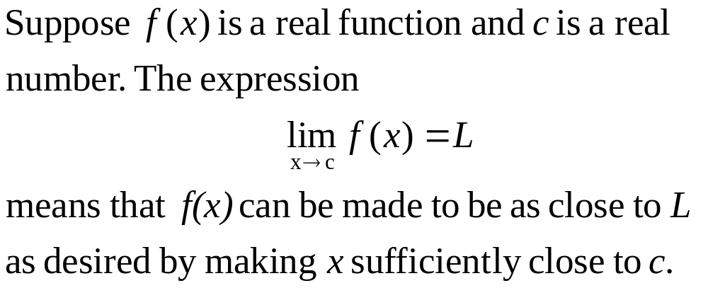
Limits of a Function

Slide 3
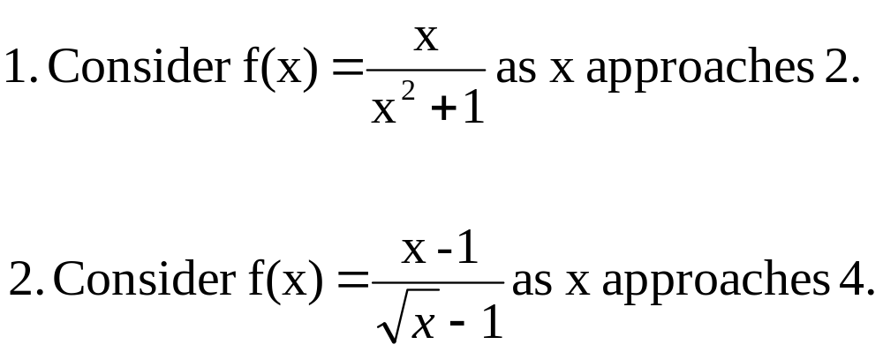
Limits of a Function

Slide 4
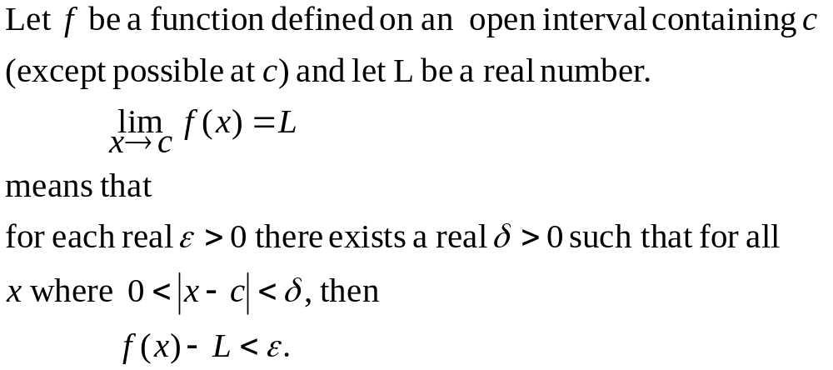
Limits of a Function Definition

Slide 5
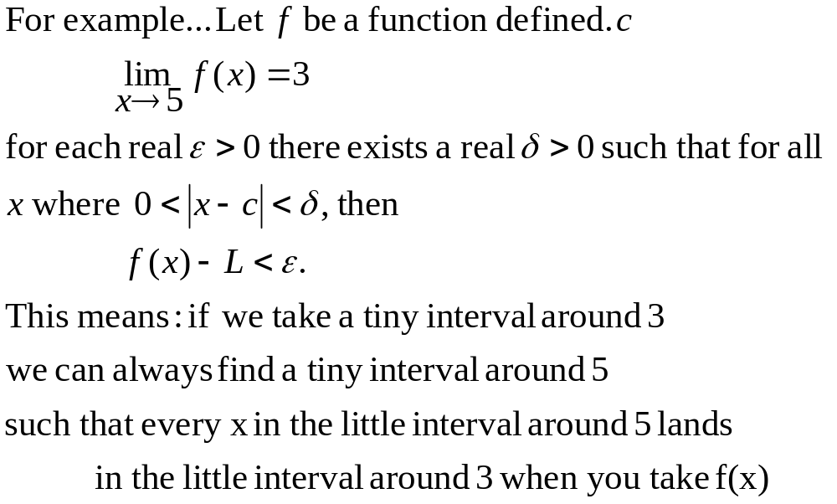
Limits of a Function Definition

Slide 6
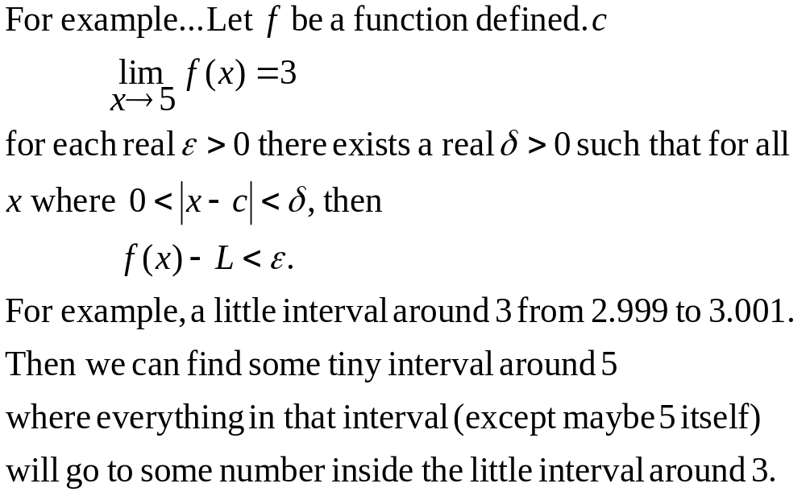
Limits of a Function Definition

Slide 7
Limit of a Function at Infinity
Related to the concept of x approaching some finite number is the concept of x approaching positive or negative infinity
To say x approaches positive infinity is to say that x gets larger and larger
To say x approaches negative infinity is to say that x gets smaller and smaller

Slide 8
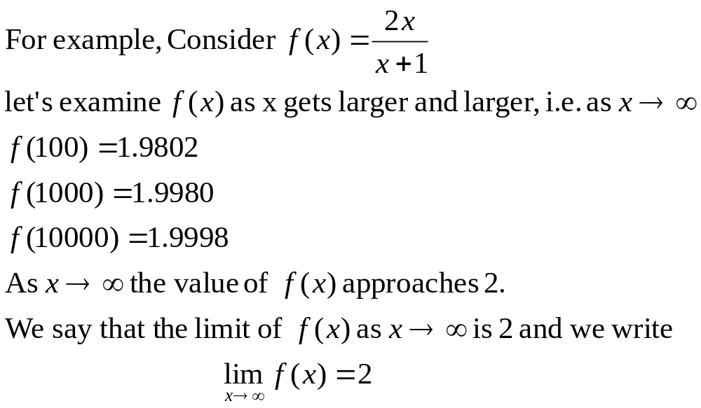
Limit of a Function at Infinity - Example

Slide 9
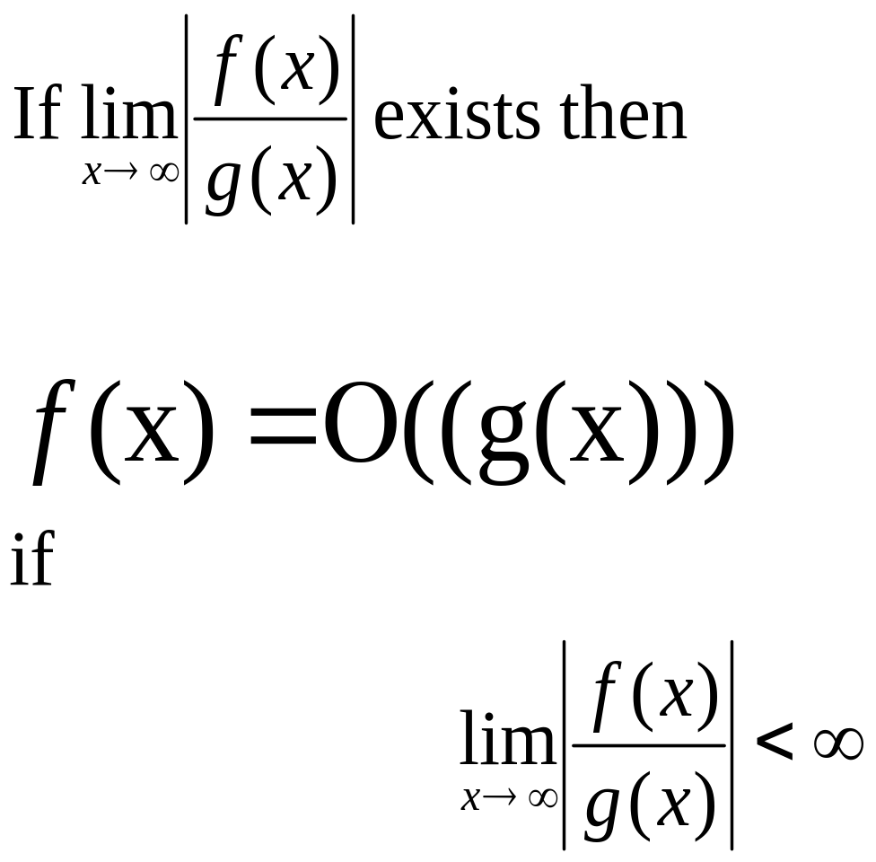
Big Oh - Definition

Slide 10
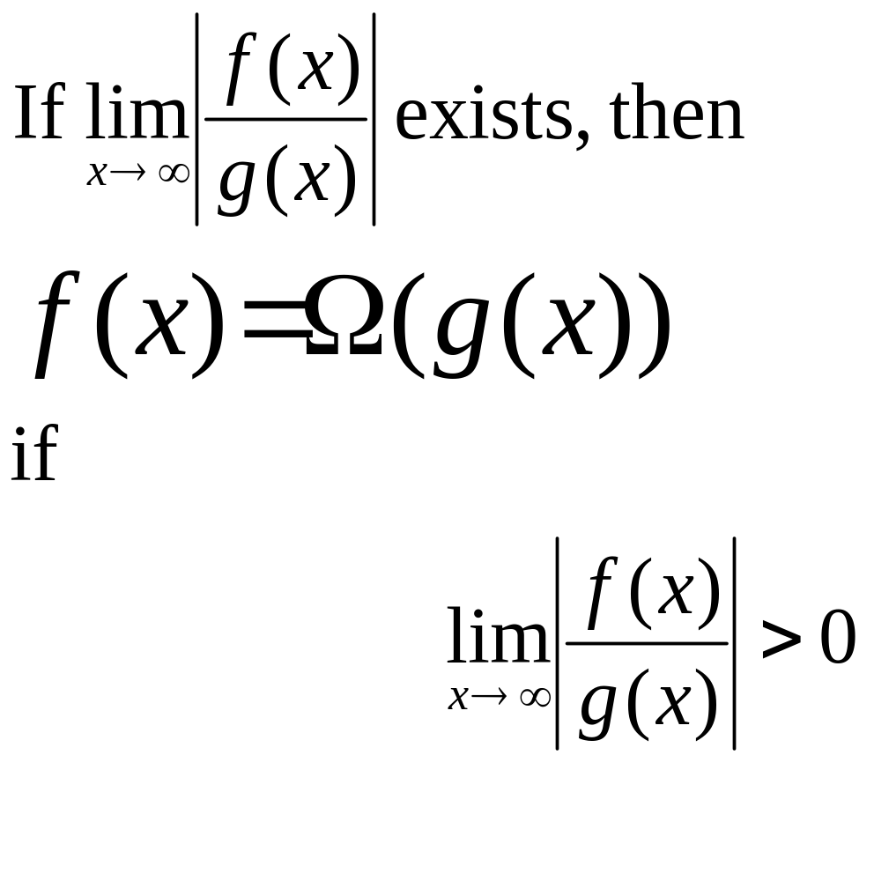
Omega Notation - Definition

Slide 11
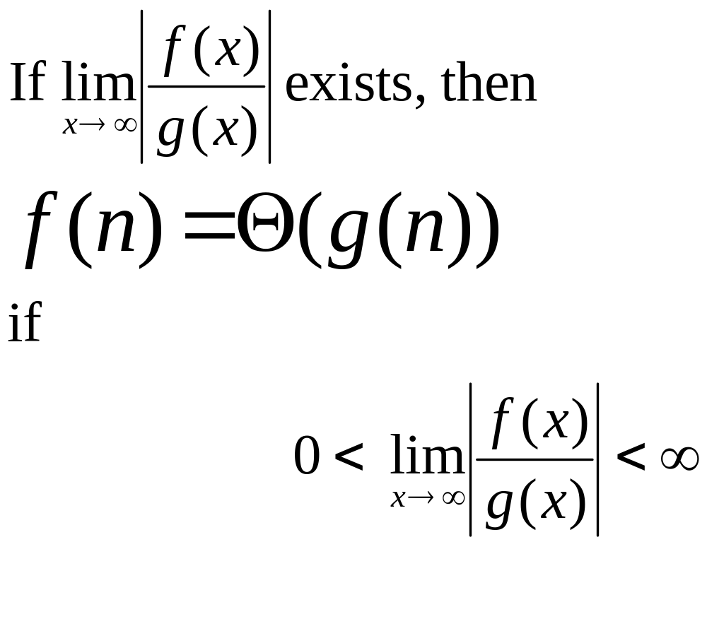
Theta Notation

Slide 12
Topics Covered
Limits of a function
  Formal Definition
  Limit of a function at infinity
Asymptotic Analysis using limits
  Big Oh Notation
  Omega Notation
  Theta Notation

